Slide 1

AI-Based Coal Mine Safety Robot
BY
AATHIKESAVAN B
NANDHA RJ
NAVEENKUMAR K
DEEPAK K
III-YEAR ECE

Slide 2
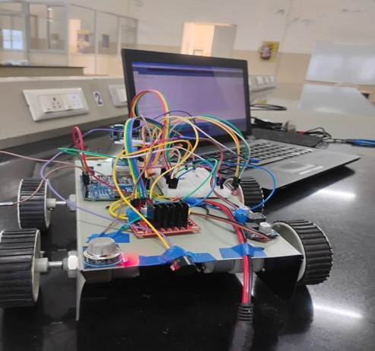
INTRODUCTION:
Prototype:
Coal mining is one of the most dangerous industries in the world.
Workers inside mines face serious risks such as toxic gas leakage, poor visibility, and tunnel collapse.
Manual monitoring of underground conditions is difficult and unsafe.
To solve this problem, we developed an AI based autonomous coal mine monitoring robot that can detect gases, avoid obstacles, and provide live video streaming.

Slide 3
Problem Statement:
Coal mines contain dangerous gases like Methane (CH₄) and Carbon Monoxide (CO).
These gases can cause:
Explosions
Suffocation
Fatal accidents
Human inspection inside deep tunnels is risky.
Therefore, a remote monitoring robotic system is required to ensure miner safety.
Objectives of the Project:
The main objectives of this project are:
• Detect harmful gases inside coal mines
• Provide live video monitoring of underground tunnels
• Detect obstacles automatically
• Support both manual control and autonomous navigation
• Alert when gas concentration exceeds safety limits

Slide 4
Existing System:
In traditional mining systems:
• Gas monitoring is done using fixed sensors
• Workers manually inspect tunnels
• Limited remote monitoring
• No real-time visual inspection
• High risk for human workers
Limitations:
• Slow response to hazards
• Human safety is compromised
• Limited automation
Hardware Components:
The system consists of the following components:
Microcontroller
• ESP32
Sensors
• MQ-4 Gas Sensor (Methane detection)
• MQ-7 Gas Sensor (Carbon Monoxide detection)
• HC-SR04 Ultrasonic Sensor (Obstacle detection)
Camera
• ESP32-CAM for live video streaming
Motor System
• L298N Motor Driver
• DC Motors

Slide 5
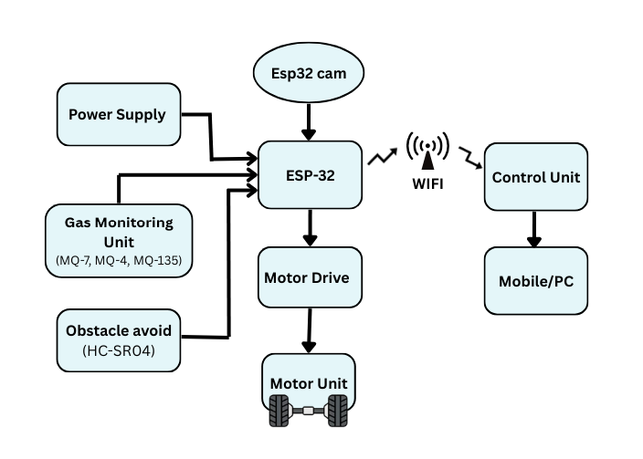
Block Diagram & Methodology:
Step-by-step system operation:
ESP32 connects to WiFi network
Sensors continuously monitor environmental conditions
Gas data is sent to the web dashboard
Camera provides live video streaming
Robot can be controlled manually using the web interface
In auto mode, robot navigates automatically
If dangerous gas levels are detected, warning signals are triggered.

Slide 6

Advantages:
• Improves miner safety
• Real-time monitoring
• Reduces human risk
• Autonomous navigation capability
• Low-cost solution
• Easy remote monitoring
Future Implementation:
This project can be further improved by adding:
• AI based gas prediction
• Thermal camera for fire detection
• GPS or indoor localization
• Machine learning for tunnel mapping
• LoRa communication for deep mines
These improvements can make the system more advanced and reliable.

Slide 7


